Slide 1
DESAB - LINKING GROUP
Frank Mensah (6830725)
Avishek Mishra (6830736)
Karthikeyu Busa (6828811)

Slide 2














Technologies

Slide 3
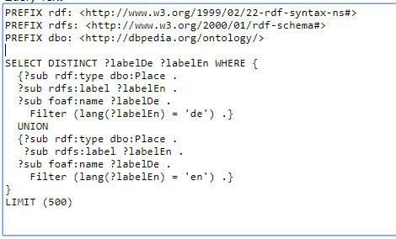
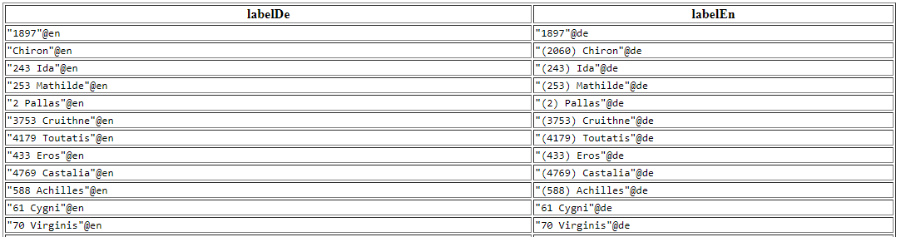
Tasks
Query Dbpedia for cities with both German and English labels

Slide 4
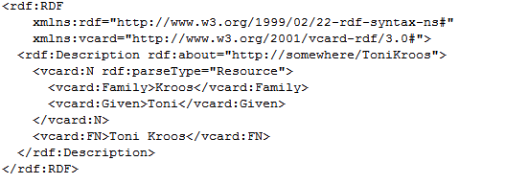
Tasks
Reading and Writing RDF in Apache Jena. We have used RDF formats are
Turtle
RDF/XML
N-Triples

Slide 5
Tasks
RDF representation in form of Node Diagram
http://.../ToniKroos
Vcard:FN
Vcard:FN
Toni Kroos
Vcard:Given
Vcard:Family
Toni
Kroos

Slide 6
Tasks
Studied Future Feature and implemented small task on it.
Studied Event Bus and implemented small task on Event bus.
Sparql query to List 100 cities for string similarity from source (http://dbpedia.org/resource/Acre,_Israel)
to Target (https://www.wikidata.org/wiki/Q200441)
6

Slide 7
Future works
To integrate the LIMES and DL-Learner
JUnit test cases for the integrated project
Documentation
To produce a human friendly graphical interface with Data-driven Documents libraries with data generated

Slide 8
Recent work on LIMES and DL-Learner
DL-Learner:
Running DL-Learner
Input: background knowledge (OWL/DL) and Positive, negative examples
Output: OWL class expressions provides all positive examples with few or none negative examples
LIMES:
Running LIMES
Input: Source and target knowledge bases, Restrictions, Properties, etc.
Output: Mappings between data sources, examples

Slide 9
Flowchart for the integration
OWL Class expression
Restrictions
OWL/DL.& Positive, Negative examples
DL-Learner
Learn from examples by ML model
LIMES
Conf. LIMES
Link & Do comparision
Mapping & examples
Input/output

Slide 10
Challenges
Familiarizing myself with the DL-Learner and LIMES
Looking at the code and understanding it
Understanding our groups objective/goals

Slide 11
Lessons
Known technologies and concepts like (Limes, DL-Learner, Maven, SPARQL, Semantic web, etc.)
Understood the value of team working
Confidence boost on our coding skills
Exposer to understanding of existing codes
Practical experience on the usage of git and Github

Slide 12
References
http://dl-learner.org/
http://dice-group.github.io/LIMES/user_manual/
http://dl-learner.org/Resources/Documents/manual.pdf

